Slide 1
Adolescent Anxiety
Ilana Blatt-Eisengart, Ph.D.
Licensed Clinical Psychologist
www.doctorilana.com
Notes:
Objectives: typical vs atypical anxiety, when to seek professional help, coping/parenting strategies

Slide 2
Typical vs. Clinical Adolescent Anxiety

Slide 3
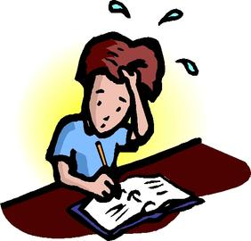
Adolescence is a scary time…
Teens’ developmental task is to achieve independence
Trying on different roles
Pushing parental boundaries
Wanting to do things themselves alternates with wanting to be taken care of
Parenting a teen is scary!
Consequences of missteps are greater
Teens are often pushing you away
Worries about their ability to reach adult goals/achievements
Notes:
Anxious parents beget anxious kids (and vice versa)! Importance of allowing kids to take things on independently to show them that you trust them and have confidence in their abilities

Slide 4
What is ‘normal’ anxiety?
Worries proportional to the problem
Able to distract oneself with enjoyable activities
Does not interfere with day-to-day functioning (social, academic, home)
Worries pass when the stressor passes
Less likely to be accompanied by physiological symptoms (restlessness, fatigue, feeling ‘on edge’)

Slide 5
What is a clinical anxiety disorder?
Types of anxiety disorders commonly seen in teens:
Generalized Anxiety Disorder
Social Anxiety Disorder
Obsessive-Compulsive Disorder
Panic Attacks/Panic Disorder
Phobias
Notes:
Mention Separation, SM as much more rare in adolescence; PTSD as related but slightly different topic and definitely different tx

Slide 6
Prevalence of clinical anxiety disorders
Most common psychological disorder experienced by Americans
NIMH says lifetime prevalence among teens is 25.1% (5.9% prevalence of a ‘severe’ disorder)
More common among girls than boys (30% lifetime prevalence among girls; 20% among boys)
Notes:
5% prevalence social anxiety; 2% panic disorder; 2% agoraphobia; 1% GAD; 15% specific phobia; OCD 1-3%

Slide 7
How do I know if we need professional help?
If you’re concerned, always a good idea to consult with someone
Symptom checker: http://www.copingcatparents.com/
The earlier a problem is addressed, the less likely it is to grow into something more severe
Is this problem interfering with functioning in day-to-day life? (Or is it likely to begin to interfere in the foreseeable future)

Slide 8
Coping Strategies
What to do and what not to do:

Slide 9
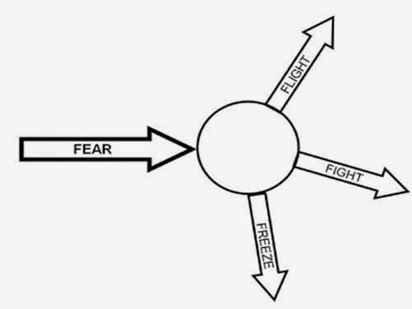
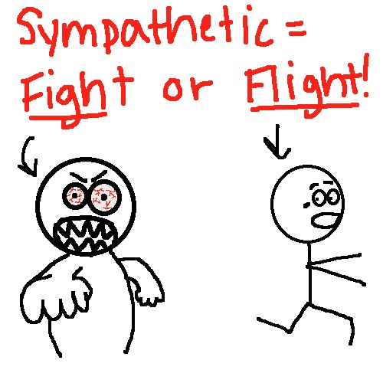
What helps???
Understand your sympathetic nervous system - ‘fight or flight’ system!

Slide 10
So..activate your parasympathetic nervous system
Deep breathing
In through the nose, out through the mouth
3-4 breathing
Guided relaxation/visualizations
Soothing sensory experiences
Pictures, scents, music
‘Cognitive Reframing’
How likely is the bad outcome to happen?
What are the possible good outcomes?
What can you do right now to try to move towards a good outcome?

Slide 11
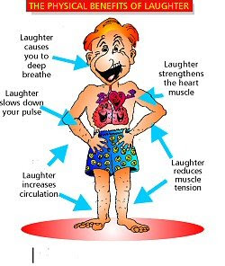
So..activate your parasympathetic nervous system
Humor!
Meditation/Mindfulness/Yoga

Slide 12
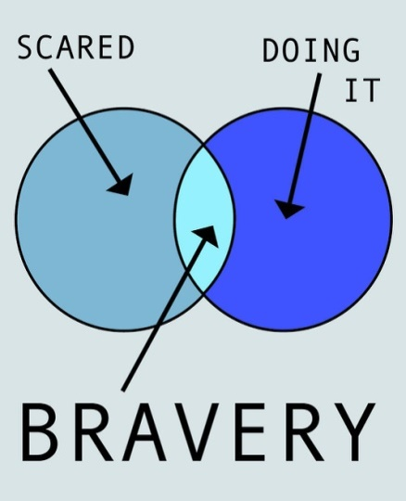
Anxiety and avoidance
Natural tendency is to avoid what is making us anxious
This almost always makes it worse!
An 8 year old’s take on anxiety treatment: “Blah, blah, blah, do what you’re afraid of”
Watch for your own natural tendency to protect your child- they need to face challenges and even failures to build their self-confidence.
Don’t inadvertently send a message that
you don’t think they are competent
Notes:
Discuss exposure

Slide 13
But teens need to choose
Remember, they are building their independence!
You cannot force teens to face their anxiety
Teens need to understand these concepts and choose to challenge themselves
You want to be on your child’s side, fighting the anxiety together!
Helps to externalize the anxiety-
Not “You never try anything new!”
But “Your anxiety is keeping you from potentially exciting or important experiences!”

Slide 14
If Avoidance Persists…
Probably a good sign that you need professional help
Exposure is an important part of CBT treatment for anxiety – controlled exposure to the feared situation/thought/experience until the person habituates
Habituation = Ride the anxiety wave!

Slide 15
Caveats:
Panic attacks and OCD work a little differently
Focus on breathing during panic attacks can be counterproductive – more important to ride the wave, know what is happening, know that it won’t last forever
Exposure/habituation are key parts of treatment for these disorders and should probably be introduced by a professional with specific experience in these areas

Slide 16
If you do need more help…
Licensed psychotherapist (psychologist, psychiatrist, social worker, LMHC) who is experienced with child/adolescent anxiety
Cognitive-Behavioral Therapy has a long history of effectiveness in treating anxiety disorders
Consult with pediatrician/psychiatrist regarding medication – usually most helpful in conjunction with therapy (at least in the long-term)

Slide 17
Discussion and Questions

Slide 18
Resources
Books for Parents:
Freeing your Child from Anxiety; Tamar Chansky
You and your Anxious Child; Ann Marie Albano and Leslie Pepper
Helping your Anxious Child; Ron Rapee et al
Books for Teens:
My Anxious Mind: A Teen’s Guide to Managing Anxiety and Panic; Michael Tompkins et al
Freaking Out: Real-life Stories about Anxiety; Polly Wells
The Anxiety Workbook for Teens; Lisa Schab
Comprehensive list of books broken up by age group can be found at http://www.copingcatparents.com/Books_Resources

Slide 19
Resources:
Websites
http://youth.anxietybc.com
Anxiety and Depression Association of America www.adaa.org
www.worrywisekids.org
www.copingcatparents.com
Apps
List of apps at http://www.adaa.org/finding-help/mobile-apps
Mayo clinic ‘anxiety coach’ app (iPhone only at present)
Mindshift (available for iPhone or Android)
OCD-specific resources
http://www.ocdeducationstation.org/images/uploads/guides/got-ocd.pdf
http://kids.iocdf.org/
Talking Back to OCD; John March and Christine Benton

Slide 20
My contact information
www.doctorilana.com
781-315-6248
Dr.ilanabe@gmail.com
My practice is located at 22 Woburn St., Suite 34 in Reading

